Slide 1

عيلة رقمية
معاً نصنع مستقبلًا أكثر تطورًا ووعيًا بالتكنولوجيا!

Slide 2
الرؤيه
نطمح إلى بناء مجتمع رقمي متكامل، تمتلك فيه كل أسرة مصرية المهارات اللازمة لاستخدام التكنولوجيا بفعالية وأمان، مما يسهم في تحسين جودة الحياة، وتعزيز فرص التعلم والعمل، والمشاركة الفعالة في الاقتصاد الرقمي.
الرسالة
نسعى إلى تمكين الأسرة المصرية من خلال التوعيه بمبادرات مصرالرقمية، والتي تتيح لجميع أفراد الاسرة الاستفادة من التكنولوجيا الحديثة، وتؤهلهم لسوق العمل المتطور، مما يحقق نموًا مستدامًا ويواكب تطلعات رؤية مصر الرقمية.

Slide 3
أهداف الحملة
نشر الوعي بأهمية التعلم الرقمي لكافة الفئات العمرية.
توفير دورات تدريبية متخصصة ضمن مبادرة "مصر الرقمية".
تمكين الأسرة المصرية من الأدوات الرقمية التي تساعدها في تطوير مستقبلها.

Slide 4

الفئات المستهدفة
الأطفال: تحفيزهم على استكشاف البرمجة وأساسيات التكنولوجيا.
الشباب: تمكينهم من المهارات التقنية المطلوبة في سوق العمل.
الآباء والأمهات: مساعدتهم على استخدام التكنولوجيا بفعالية لدعم تعليم أبنائهم وتحسين مهاراتهم المهنية.

Slide 5
Key Partners
Key Activities
Value Proposition
Customer Relationship
Customer Segments
Projects Challenges
Ministry of Communications and Information Technology.
Egypt Digital Community Digital Initiative organizations supporting digital education.
Local tech businesses interested in digital literacy.
Raising awareness about digital transformation.
Conducting training programs and workshops.
Collaborating with relevant entities to promote digital adoption.
Free access to digital learning courses.
Empowering Egyptian families with essential digital skills.
Enhancing career opportunities through digital education.
Easy and convenient learning for all family members
Continuous interaction through digital content and training programs.
Community engagement via social media.
Parents looking to enhance their digital knowledge.
Students and fresh graduates.
Job seekers aiming for digital career opportunities.
Families interested in modern education
Business Model Canvas
Channels
Key Resources
Social media platforms.
Workshops and training sessions.
Video content and online educational materials.
Digital educational content
Marketing and social media team
Social media platforms for outreach
Volunteer trainers and experts
عيلة رقمية
22-Feb-2025
Iteration #1
Cost Structure
Competitors
Revenue Streams
Social media advertising expenses.
Content creation and platform management
Hosting and technical infrastructure costs
Other Government Initiatives
E-learning Platforms
Private Initiatives & Paid Training Programs
Educational Content on Social Media
Self-funded by project organizers
Personal contributions from team members
Organizing workshops and training sessions
Notes:
Summarizing all information in previous slides the in one Canvas

Slide 6
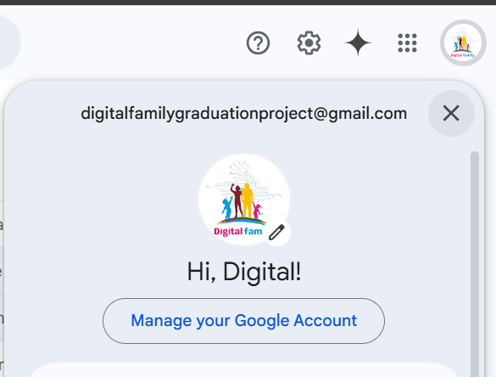
1- Gmail created as below, to start creation remaining platforms
digitalfamilygraduationproject@gmail.com

Slide 7
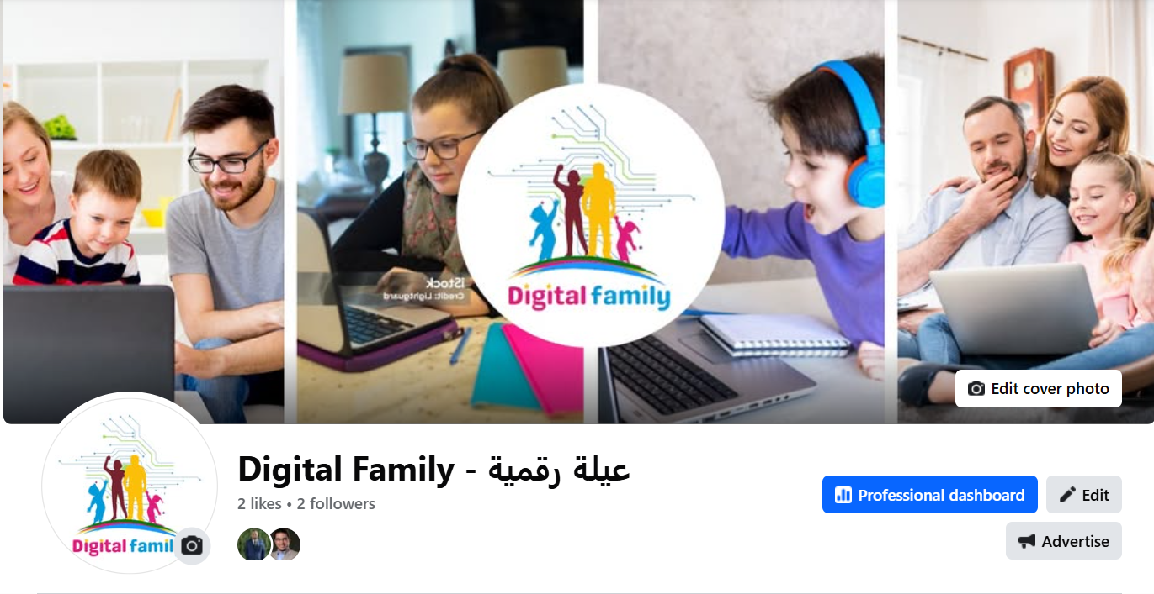
2- Facebook page created with below URL
https://www.facebook.com/DigitalFamilyGraduationProject/

Slide 8
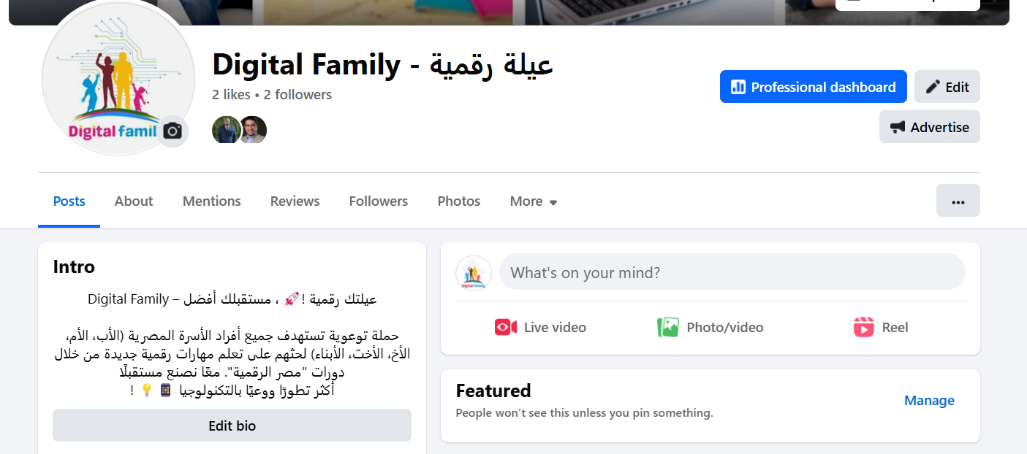
2- Facebook page intro, Bio, and needed data have been filled
https://www.facebook.com/DigitalFamilyGraduationProject/

Slide 9
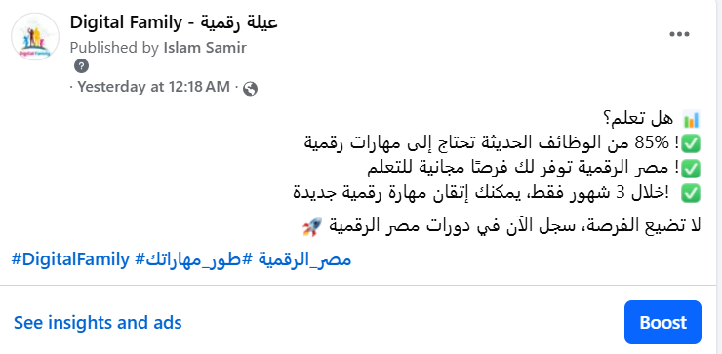
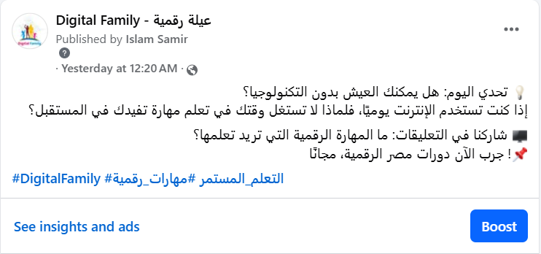
2- Facebook Posts have been published successfully
https://www.facebook.com/DigitalFamilyGraduationProject/

Slide 10
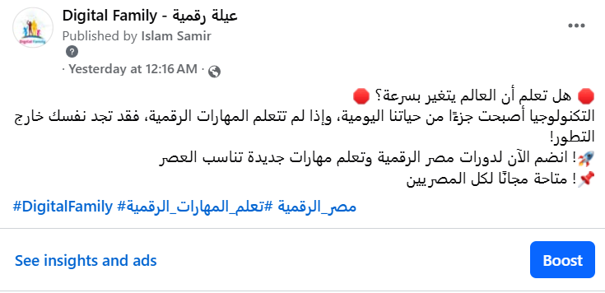
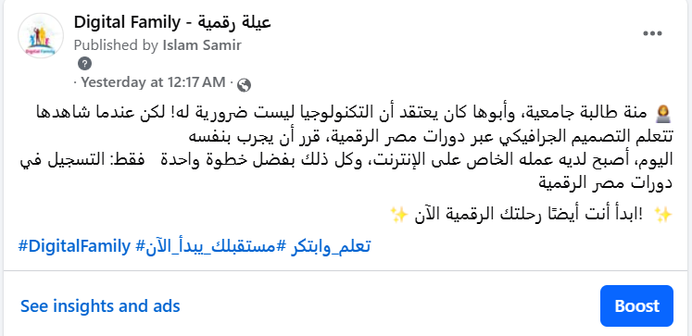
2- Facebook Posts have been published successfully
https://www.facebook.com/DigitalFamilyGraduationProject/

Slide 11
2- Facebook Posts have been published successfully
https://www.facebook.com/DigitalFamilyGraduationProject/

Slide 12
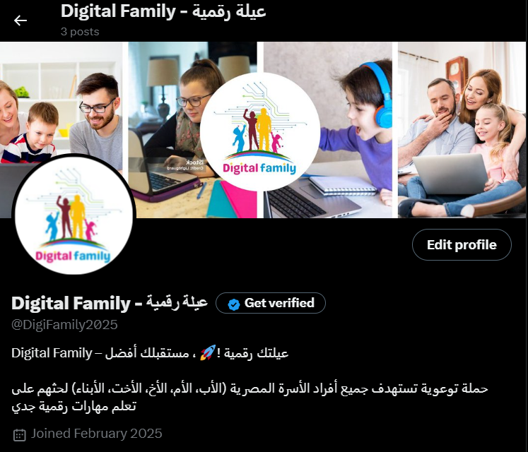
3- X page created with below URL
https://x.com/DigiFamily2025

Slide 13
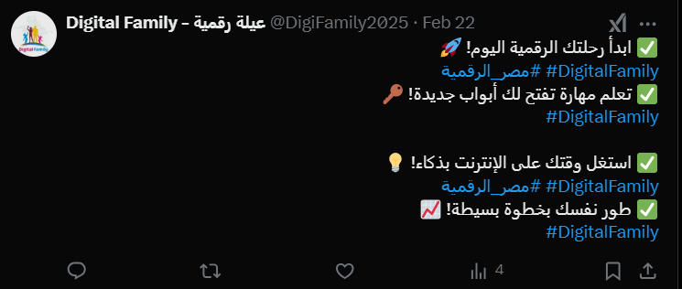
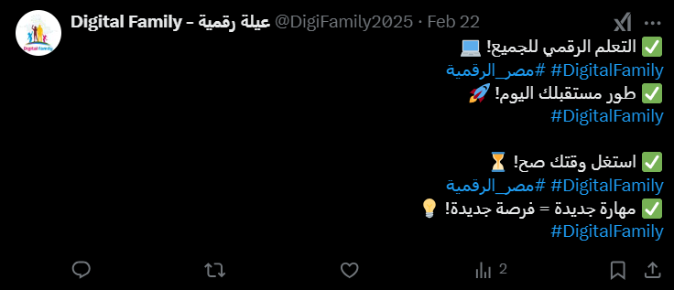
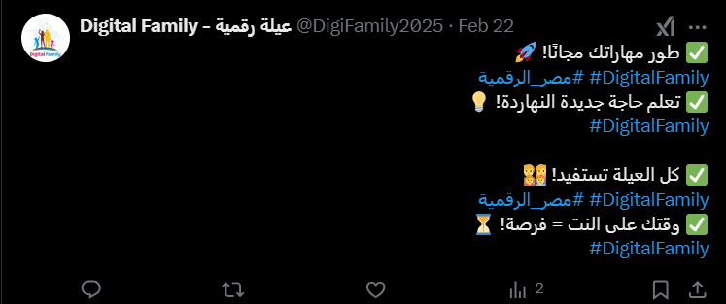
3- X Posts have been published successfully
https://x.com/DigiFamily2025

Slide 14
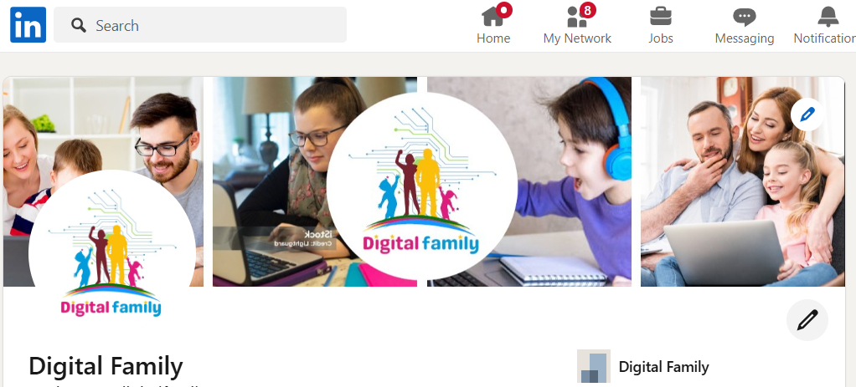
4- LinkedIn platform creation with below URL
https://www.linkedin.com/in/digitalfamily2025/

Slide 15
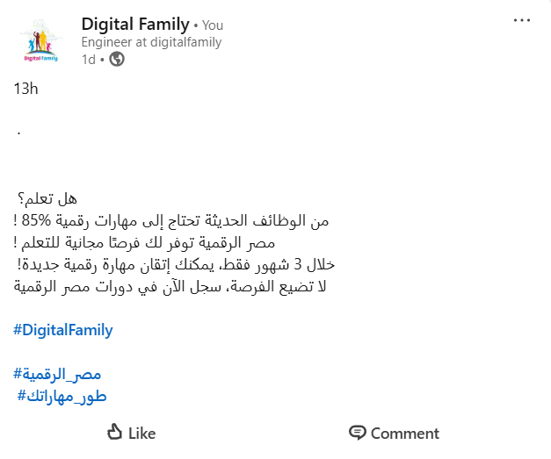
4- LinkedIn Posts have been published successfully
https://www.linkedin.com/in/digitalfamily2025/

Slide 16
4- LinkedIn Posts have been published successfully
https://www.linkedin.com/in/digitalfamily2025/

Slide 17
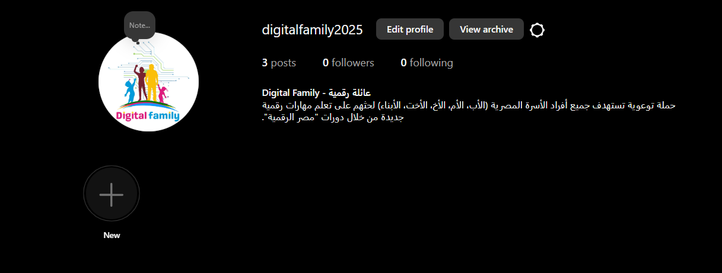
5- Instagram Platform account has been created with below URL
https://www.instagram.com/digitalfamily2025/

Slide 18
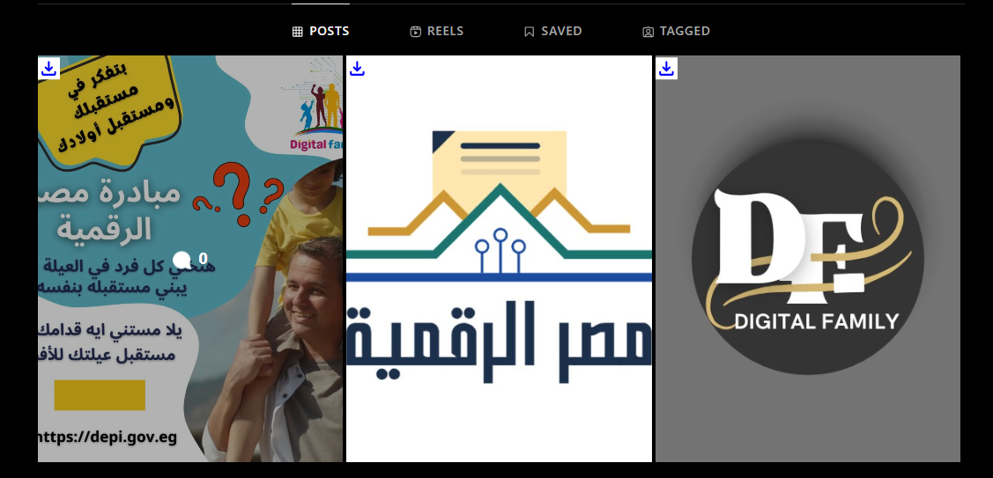
5- Instagram posts (Videos and Pictures have been published successfully.
https://www.instagram.com/digitalfamily2025/

Slide 19
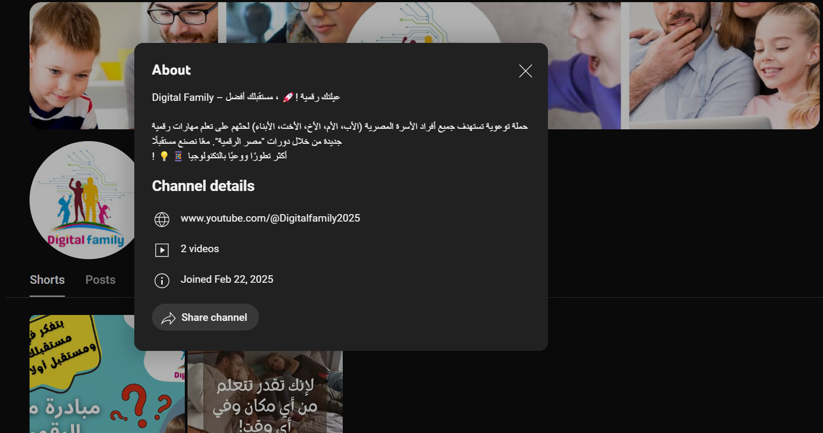
6- YouTube account/Channel has been created with below URL https://www.youtube.com/@Digitalfamily2025

Slide 20
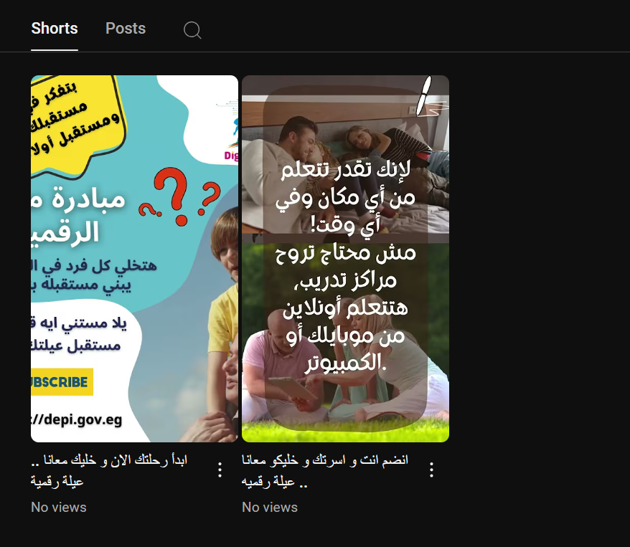
6- YouTube Posts have been published successfully. https://www.youtube.com/@Digitalfamily2025

Slide 21
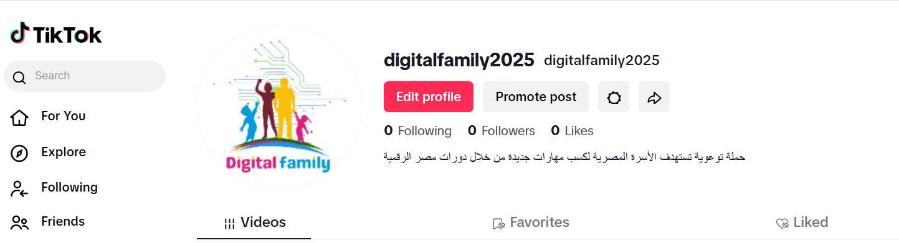
7- TikTok platform account has been created with below URL https://www.tiktok.com/@digitalfamily2025

Slide 22
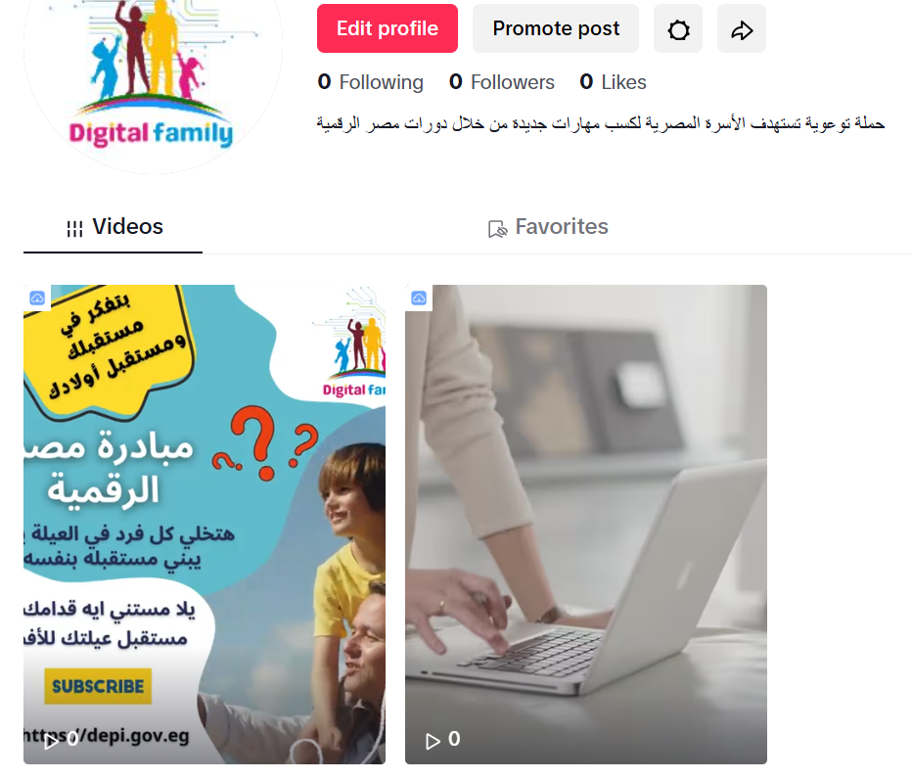
7- TikTok videos have been published successfully https://www.tiktok.com/@digitalfamily2025

Slide 23
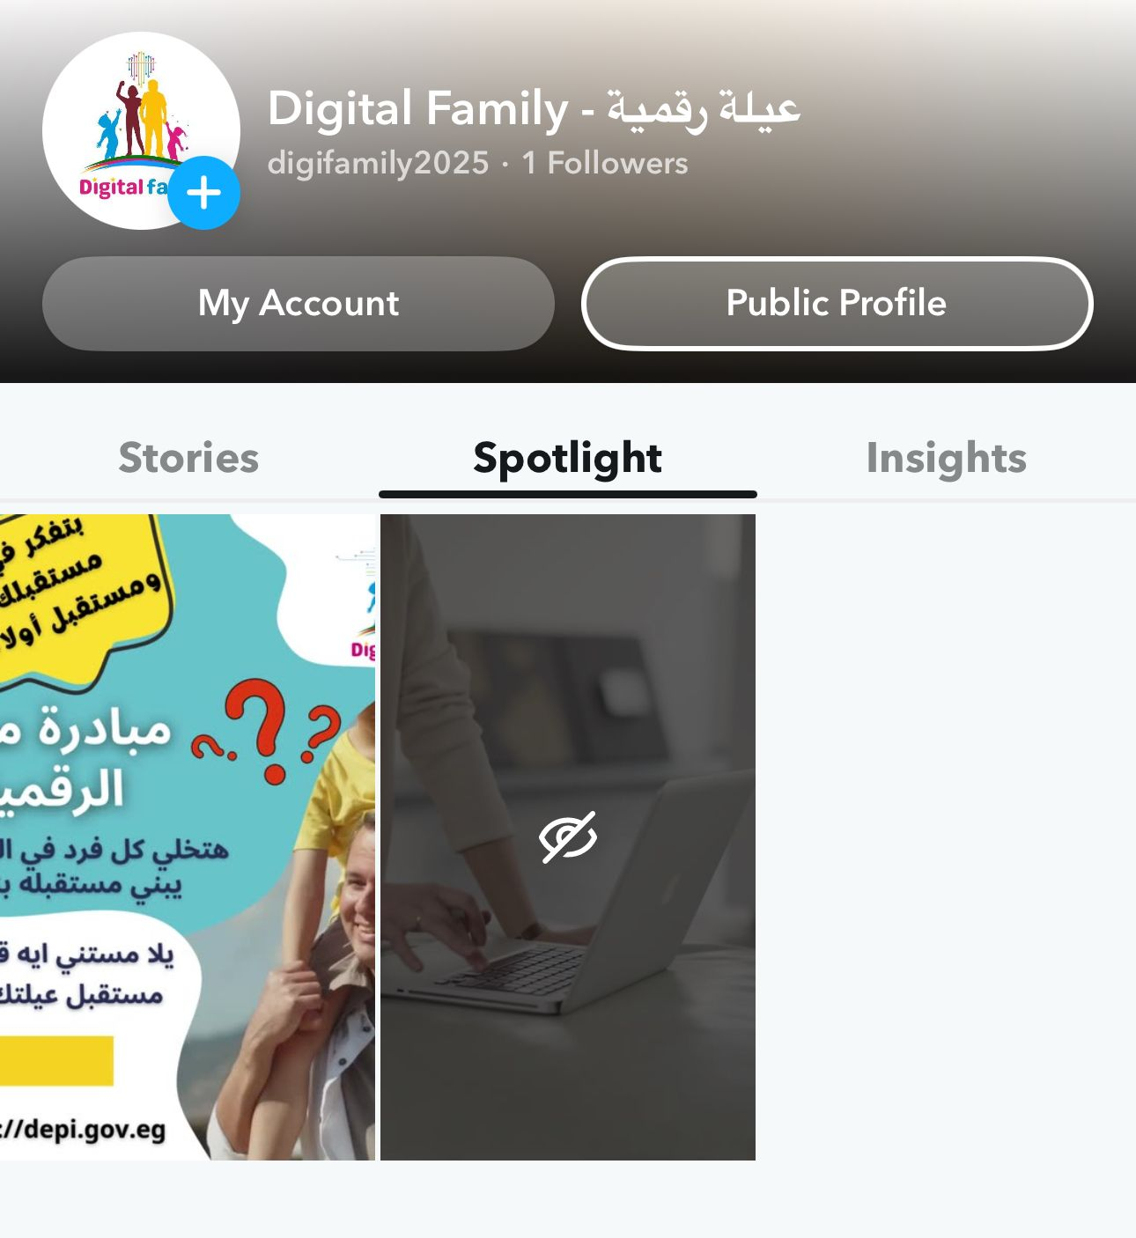
8- Snapchat account has been created successfully, also videos have been published.

Slide 24
What is next ?
As we move forward, our focus will be on expanding the reach and impact of Digital Family. Here’s what’s next:
🚀1- Launching Paid Campaigns
We will invest in targeted paid advertising to reach a larger audience and ensure more families benefit from Egypt Digital’s initiatives.
🎯2- Expanding Audience Reach
Our goal is to engage a wider segment of Egyptian families by utilizing various digital platforms effectively.
💡3- Innovative Awareness Campaigns
We will develop creative and interactive campaigns to make digital learning more engaging and accessible for all family members.

Slide 25
What is next ?
4-Collaborations & Partnerships
Partnering with organizations, influencers, and educational platforms to enhance visibility and credibility.
📊5- Tracking and Improving Impact
Using data analytics to measure engagement, optimize content, and improve our strategies.
🌍6- Community Engagement & User Feedback
Encouraging user-generated content, success stories, and direct engagement to create a strong learning community.
👉 We’re just getting started! The future of digital learning for Egyptian families is brighter than ever. 🚀

Slide 26
Thanks

